Slide 1
Supporting Palliative Care for Patients with Long-term Care Demands
Presenter: Prof. Lin Chia-Chin
Head of School
Alice Ho Miu Ling Nethersole Charity Foundation Professor in Nursing
School of Nursing, The University of Hong Kong

Slide 2
Where do People Die Globally?

Slide 3
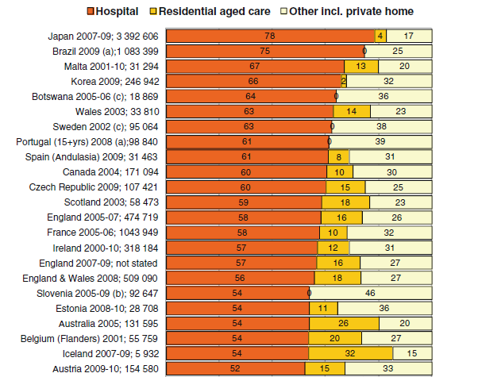
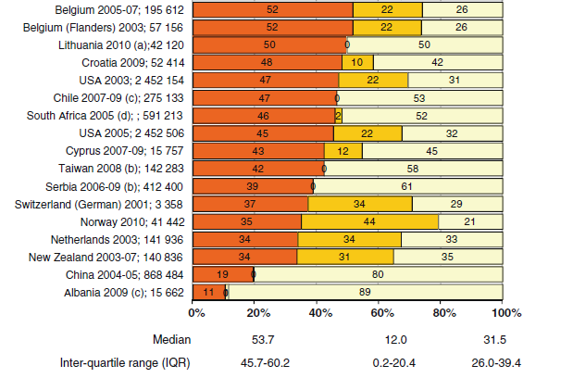
Where do people die? An international comparison of the percentage of deaths occurring in hospital and residential aged care settings in 45 populations
Broad, Joanna B; Gott, Merryn; Kim, Hongsoo; Boyd, Michal; Chen, He; et al.International Journal of Public Health; Basel Vol. 58, Iss. 2, (Apr 2013): 257-267.DOI:10.1007/s00038-012-0394-5
In Hong Kong, Over 93% of all deaths occurring in HA hospitals
Notes:
This study does not show HK, but as we know from gov statistics, more than 90% of deaths occur in hospitals.

Slide 4
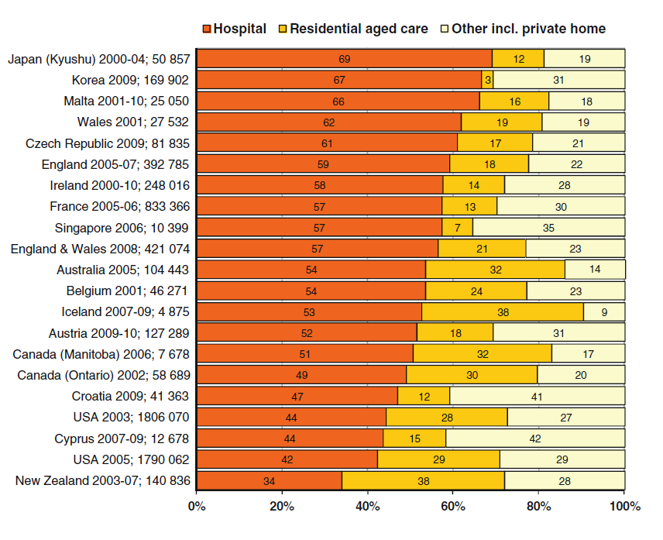
Location of Death Among People Aged 65+

Slide 5
Death in LCT Facilities
Canada
Around 40-50% of residents living in LTC homes die each year (Canadian Palliative Alliance, 2012)
Canada, UK, Australia
Approximately 24% of all deaths occur in LTC in Canada (Menec et al., 2012). Similar trends exist in UK, USA, Astralia. it is estimated that by 2020, this number will reach up to 39% (Fisher et al, 2000).
USA
30% of Medicare deaths in hospitals are recent transfers from LTC.

Slide 6
HK
35% of all deaths in HA hospital are RCHE residents
Taiwan
around 15% of all deaths are either recent transfers from LTC or occur in LTC (2016, Social and Family Affairs Administration)
So…
LCT facilities are a major provider of end-of-life care for older adults

Slide 7
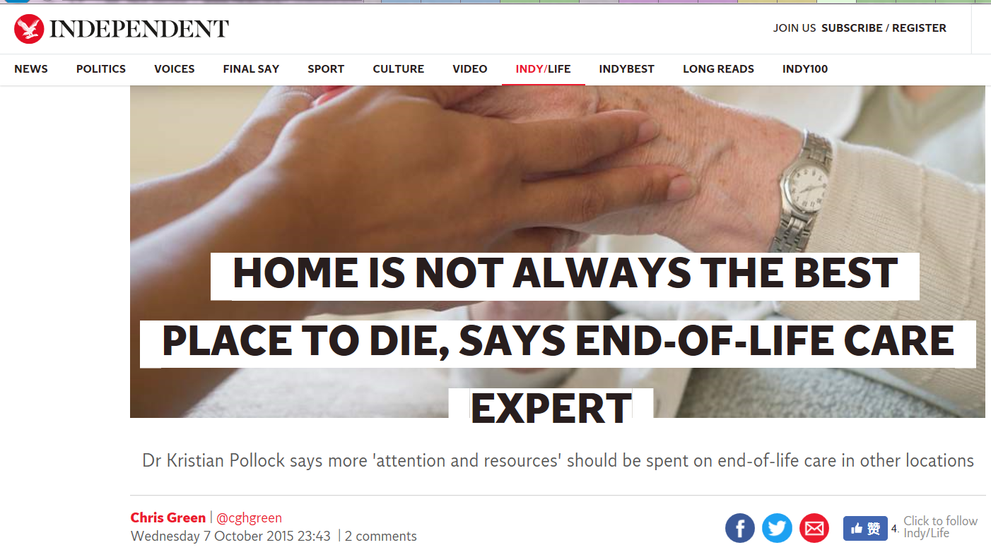
Preferred places of death? NOT necessarily home...
Do Patients Want to Die at Home? A Systematic Review of the UK Literature, Focused on Missing Preferences for Place of Death
Hoare S, Morris ZS, Kelly MP, Kuhn I, Barclay S (2015). PLOS ONE 10(11): e0142723. https://doi.org/10.1371/journal.pone.0142723
Notes:
https://www.independent.co.uk/life-style/health-and-families/health-news/home-is-not-always-the-best-place-to-die-says-end-of-life-care-expert-a6685386.html

Slide 8
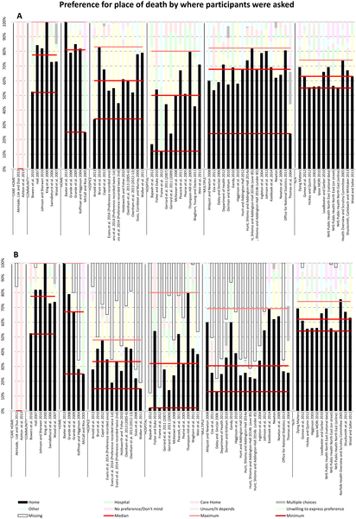
Fig 6. PPOD by where participants were asked (A) and including missing data (B).
Hoare S, Morris ZS, Kelly MP, Kuhn I, Barclay S (2015) Do Patients Want to Die at Home? A Systematic Review of the UK Literature, Focused on Missing Preferences for Place of Death. PLOS ONE 10(11): e0142723. https://doi.org/10.1371/journal.pone.0142723
https://journals.plos.org/plosone/article?id=10.1371/journal.pone.0142723

Slide 9
Preferences for place of death by where participants were asked
In the two studies where participants were care home residents, 100% chose care home as their PPOD.
Participants at home or in the community tended to prefer death at home (median 81% and 78% respectively).

Slide 10
Experiences of Older People Dying in Nursing Homes
Physical discomfort of dying
Negative psychosocial experiences
Unmet support with spiritual needs
Inadequate care received and physical environment
(Greenwood, Menzies-Gow, Nilsson, et al, 2017, correction in 2018)

Slide 11
Summary of the Evidence about Palliative Care in NHs in US
Symptom burden
EOL transitions
Goals of care discussion and advance directives
NH-specific palliative care measures
Tests of palliative care interventions in NHs
J Palliat Med. 2013 Oct; 16(10): 1180–1187.
Geriatric Palliative Care in Long-Term Care Settings with a Focus on Nursing Homes
Mary Ersek, and Joan G. Carpenter

Slide 12
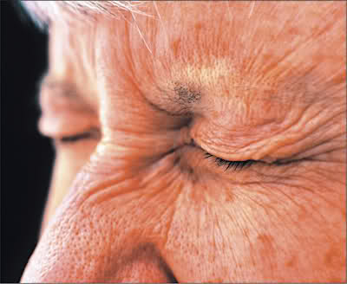
Symptom Burden
Pain
Dyspnea
Feeding problems
Delirium
Incontinence
Breathing

Slide 13
Burdensome Transitions at EOL
Many NH residents are hospitalized in the final weeks of life and receive burdensome treatments with little benefit
Completion of Ads can minimize unnecessary transitions.

Slide 14
Goal of Care Discussions and ADs
65% of NH residents had an AD.
The most common types of ADs were living wills and DNR orders.
Decisions about other interventions (e.g., artificial nutrition, hydration, antibiotics) are not common.

Slide 15
3 Models in NHs
Hospice partnerships
External palliative care teams
Facility-based teams
27% of US nursing homes reported having a special program or specially trained staff for hospice and palliative care.

Slide 16
An Excellent Example of Sharing Resources
Canadian Virtual Hospice www.virtualhospice.ca
Notes:
National website dedicated to
providing information support for people
dealing with life-threatening illness and loss
information for patients, families and
health care providers

Slide 17
Singapore ACP 2.0 movement from Hospital to clinics & Nursing homes (Jie, Quan, 2018)

Slide 18
Hong Kong Overview
Strategic Plan for Palliative care came out in 2017.
Palliative Care development in HK Hospital Authority (HA)
Expand palliative home care
Enhance PC support to elderly residents in RCHEs

Slide 19
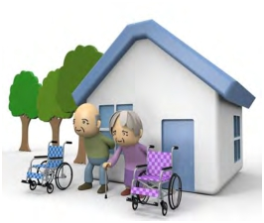
Hong Kong Preferred Place of Death
Home
30.8%
Hospital
51.8%
Aged/ Nursing
home/ Hospice
16.2%
Others
0.2%
Eng-Kiong Yeoh

Slide 20
Preferences of EoLC among Nursing Home Residents
Advance directive and end-of-life care preferences among Chinese nursing home residents in Hong Kong
35% would prefer to die in RCHEs.
Chu LW, Luk JKH, Hui E et al. Am Med Dir Assoc. 2011

Slide 21
Hong Kong Residential Care Homes for Elderly
93,600 live in RCHEs in 2016. Mostly chronically ill.
Around 10,000 elderly residents pass away in hospital each year.
16.6% Annual percentage of deaths
Average of hospitalization times in the last 6 months: 3 times
Average lengths of stay: 28 days
Providing good quality end-of-life care is recognized vital to RCHEs.
(Lau, Tse, Chen, Lam, Lam, & Chan, 2010)

Slide 22
A Program Led by Hospital Authority HK
Community Geriatric Assessment Team. (CGAT). outreach service to frail elders living in RCHEs
(Li, 2018)
Notes:
Community Geriatric Assessment Team. (CGAT). outreach service to frail elders living in RCHEs ...

Slide 23
Enhancement of CGAT Service of EOL Care in RCHE
HK East Cluster CGAT provided EOL care in RCHE since 1/2014, strengthened by collaboration with palliative team since 10/2015.
Up to 8/2016, 58% of RCHE joined the service and received formal training.
151 patients were recruited.
82% of ACP signed in RCHE
Mean age 90
95% were chair/bedbound
On average received 4.6 months of EOL care before death
Adherance of DNACPR order was 100% in A&E and inpatient.
Shum et al., 2017

Slide 24
Haven of Hope Nursing Home
Background and setting
Subvented residential care home for the elderly, licensed by Department of Health
Provide 270 government subsidized beds for long-term care
Aged 65+, high level of frail
All residents were screened by the Standardized Care Need Assessment Mechanism for Elderly Services
Provide standard EoL medical and nursing care services

Slide 25
Haven of Hope – Dying in Nursing Home (DIN)
Aim
Offer an option of dying in the nursing home, so that they can be taken care by the staff whom are familiar with, and accompanied with their loved ones.
Case selection
Long-term illness or cancer, with stable illness symptoms and health status
Close and trust relationship among the staff, the resident and caregivers
Residents or caregivers agree to Do-Not-Attempt Cardiopulmonary Resuscitation (DNACPR)

Slide 26
Operation
Preparation: Meeting and counseling with the selected resident and family caregivers
Symptom and pain management during imminent death
Death can be certified and death certificate issued by the doctors of the Nursing Home; no need to report to the Coroner
If dying in non-office hours, the on-duty nurse will (1) follow the “Guidance for Dying assessment”; (2) contact a NH doctor via telephone; (3) After consensus with doctor, notify the caregivers the death of the resident

Slide 27
Dying in Nursing Home (DIN) Service Flow
Psychological and spiritual care
-Resident, caregiver, and other residents
-Continuous observation and support
Case selection and assessment
1. Grief and bereavement
2. Death certification
3. Body transfer and temporary storage
4. Emotional support for staff
Family meetings and counseling
Staff training /psychological preparation
Observation and care
-Symptom / pain management
-Communication with the caregivers
Adoption of Advance Care Planning
1. Preparation
2. Long-term care during imminent death
3. Support and care after the resident passes away

Slide 28
Haven of Hope Nursing Home – DIN service
Outcomes
Since 2000, the DIN service recruited and served 111 residents who died in the Nursing Home
Evaluation (2010-2017)
DIN service reduced hospital admissions, hospital days, and cost of EoL care (Hospitalization and Nursing Home care) in last year of life
Median | DIN who died in NH | DIN who died in hospital | All DIN residents | Non-DIN residents
Hospital admission | 0.5 | 2 | 1 | 2
Hospital days | 1 | 20 | 4.5 | 19
EoL care cost (HK$) | 299,867 | 384,565 | 322,035 | 388,115

Slide 29
Haven of Hope Nursing Home – DIN service
Satisfaction survey
Item | % of being satisfied/very satisfied
Residential service | 98%
Healthcare professional on updating the health status of the elderly | 97%
Symptom management | 88%
Pain management | 90%
Psychological support to the residents | 84%
Psychological support to the caregivers | 83%
Arrangement of dying | 97%
Handling of corpse | 100%

Slide 30
Projection of EOL care cost saving
Assuming the DIN service model of HOHNH is adopted in all elderly homes, potential cost saving by the Government 1 year before death HK$347,184,320
¹Page 8, Hong Kong Annual Digest of Statistics 2017, Census & Statistics Department, HKSAR
²Page 36, Hospital Authority Strategic Service Framework for Palliative Care, Hospital Authority 2017
³Chu et al., Advance Directive and End-of-Life Care Preferences Among Chinese Nursing Home Residents in Hong Kong. Journal of American Medical Directors Association, 2011,
12: 143-152)

Slide 31
Press Conference & Media Report

Slide 32
Haven of Hope – Dying in Nursing Home (DIN) Key factors to success
Close collaboration between nursing home and palliative care team
Cross-indiscipline care professional team
Doctors, nurses, social workers, pastors, OT, PT, health workers
Sufficient manpower and training
Knowledge and skills to care dying residents, psychological preparation and attitude towards dying and grief
Environmental factors
Large-sized, peaceful, and comfortable rooms for the family gathering in the last few days of life
A room with lower temperature for temporary body storage

Slide 33
LTC Residents Survey in Taiwan
Length of stay: 2.5 years
89% of resident participants indicated their preference not to be prolonged life at the end of life.
only 12% of them (12 out of 101) have made ADs.
Reasons for making ADs: no suffering, dignified death, decrease family burden, avoid family conflict
Reasons for not making ADs: not aware, no one can ask, condition not serious enough
60% of residents would make ADs after explaining
No association between Staffs knowledge /attitude and residents’ ADs
Du & Lin, 2017
Notes:
https://www.slideshare.net/ROC-MOHW/longterm-care-20-in-taiwan-respond-to-an-aging-society

Slide 34
EOL Care for Residents with Dementia
Fewer than 10% of the professionals reported discussing end-of-life care with residents with dementia and their families.
Physicians were significantly more likely to discuss life-sustaining treatment than nurses and social workers.
https://english.ey.gov.tw/News_Hot_Topic.aspx?n=FE8C5966F81D8273&sms=BBB420E471DAF6C0

Slide 35
Taiwan PC Trends for PwD (2000-2013)
Comparing features of healthcare utilization
Increasing use of PC for both dementia and cancer patients at the last six months of life;
Differences in changing patterns since 2000 found between PwD and PwC;
Both home and inpatient palliative care has increased;
Still room for improvement in utilization and in reducing disparity.

Slide 36
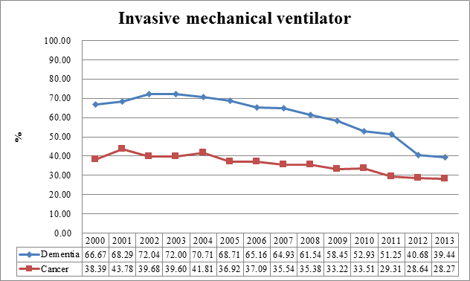
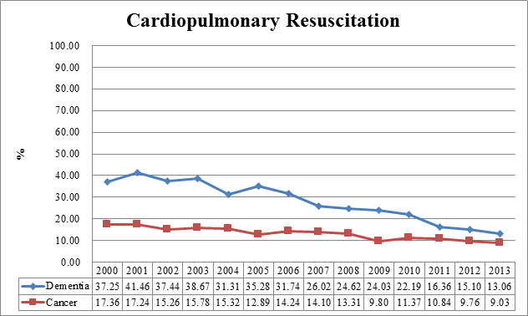
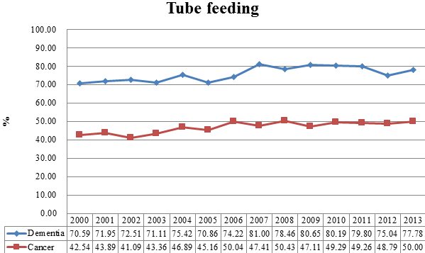
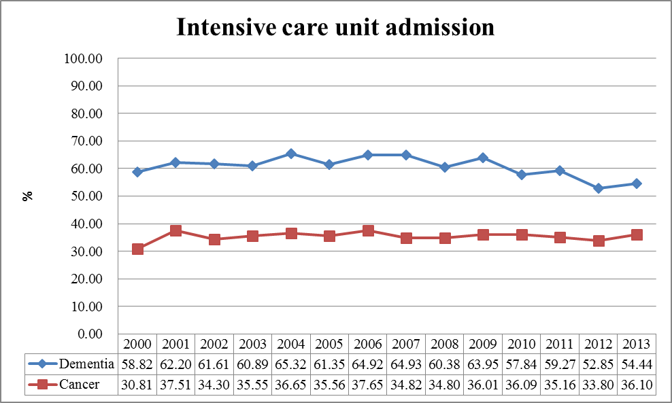
Decreasing use of CPR & IMV;
Shrinking gap between PwD & PwC.
Baseline N = 25,335
C 19,730 & D 5,605
Comobidity C&D count as C
Decreasing PwD ICU entry slightly;
Remain similar ICU entry rate for PwC.
Slight increasing use of Tube feeding for both PwD & PwC.
36
Chen (2016) www.chimei.org.tw/main/cmh_department/59310/失智安寧指引全文.pdf

Slide 37
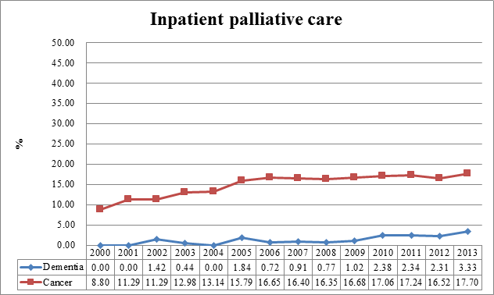
Increasing use of Inpatient PC for both PwD & PwC;
Still a wide gap between the 2 user groups!

Slide 38
Implications
to increase the availability of palliative care services in LTC facilities, e.g., palliative home care, palliative shared care
to advocate for more resources to support services for quality of end-of-life care in place in LTC facilities
2)
3)
to support living well & dying well with choices available, initiate ACP discussion as early as possible
4) to conduct more research in such services to evaluate their effectiveness

Slide 39
Integrating palliative care with other services
It is NOT other services integrating with palliative care services but ways that palliative services can reach out across the health system
David Currow

Slide 40
Living and Dying Well for an Ageing Population Building a Sustainable and Quality Palliative Care Model in LTC Facilities

Slide 41
THANK YOU

